Slide 1
Mexico’s music
2023/11/07

Slide 2
TABLE OF CONTENT
Short History of Mexico
Prehispanic Music
Traditional Music
Mariachi, Banda and Son Jarocho
Today’s Mus

Slide 3
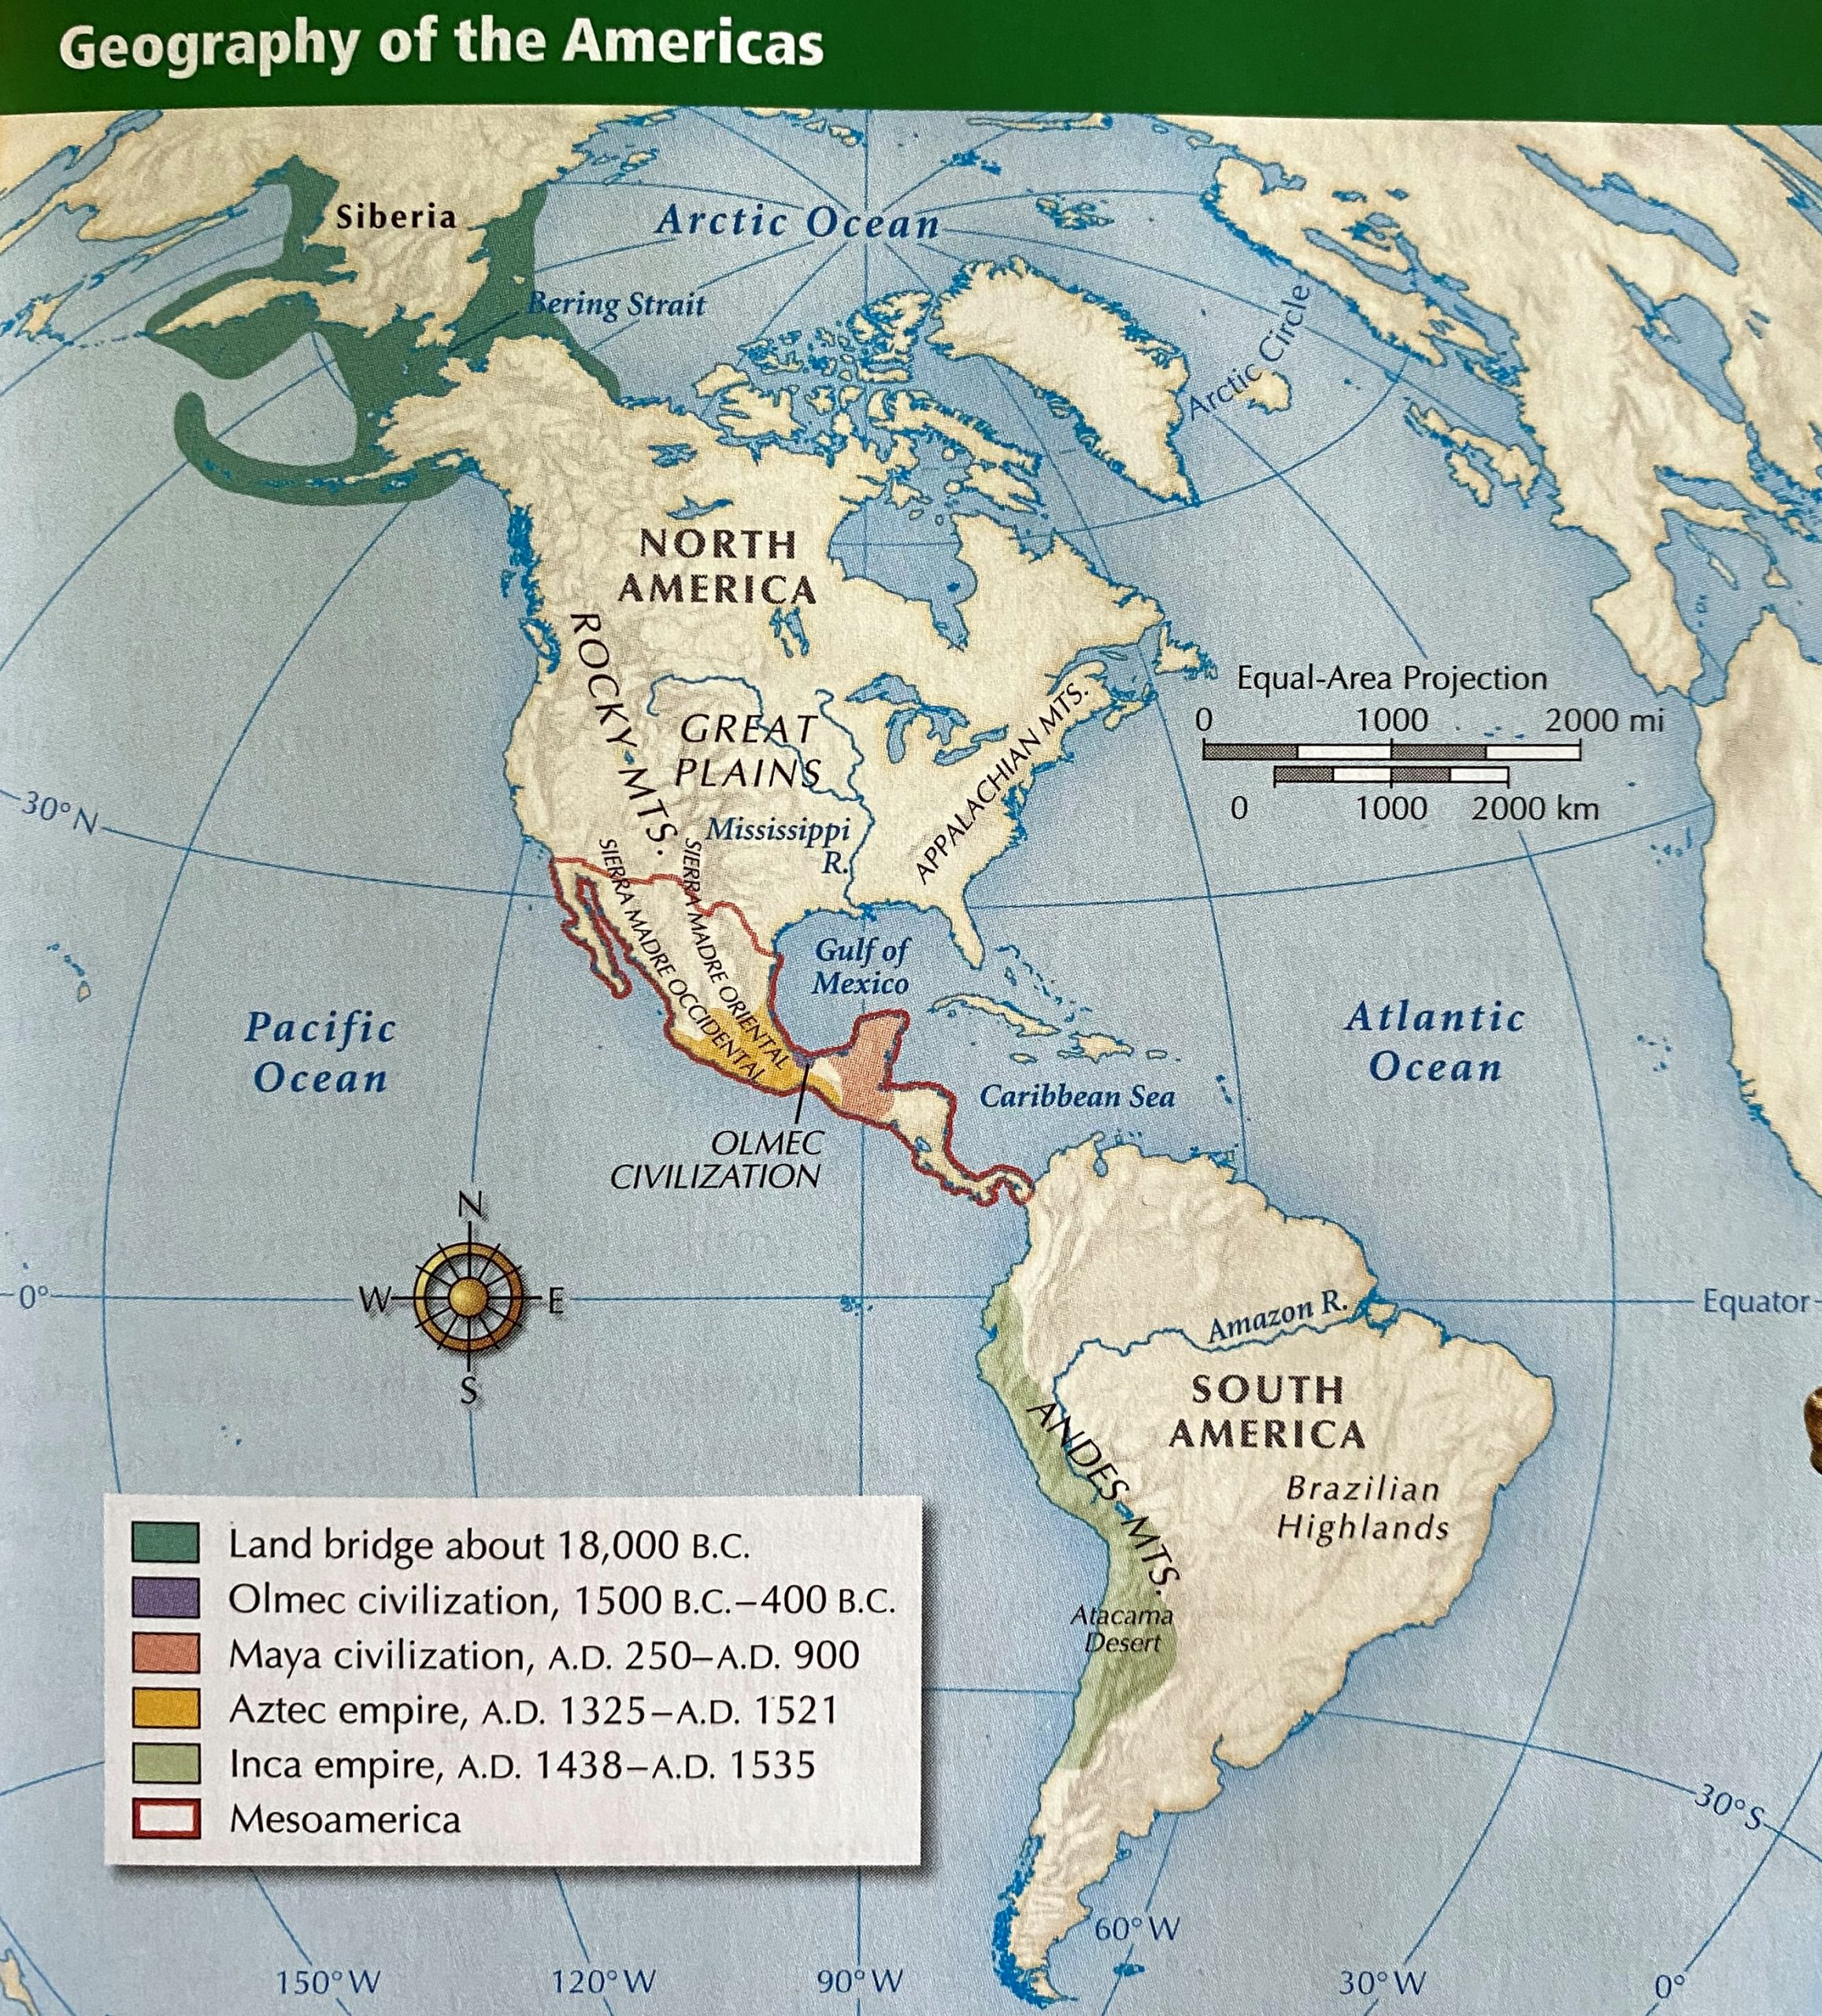
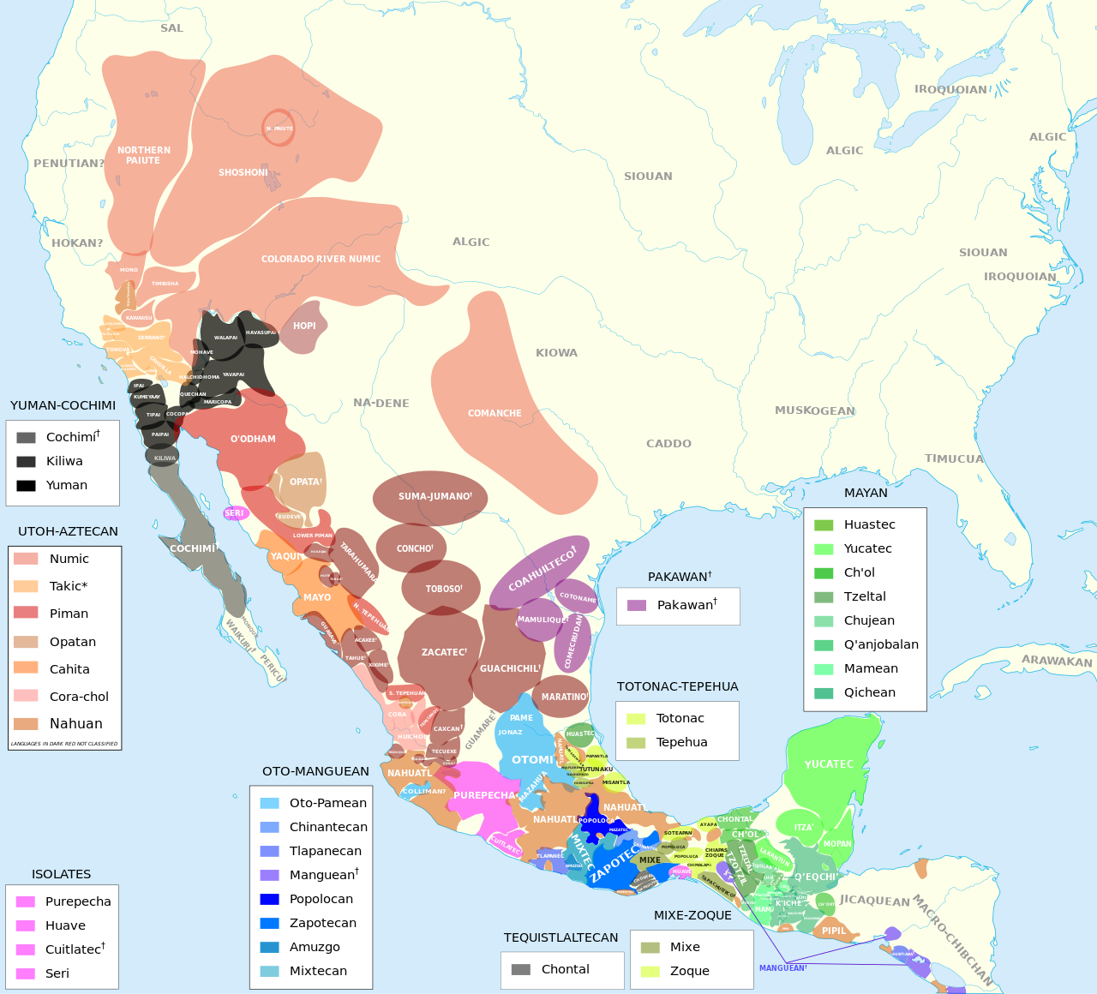
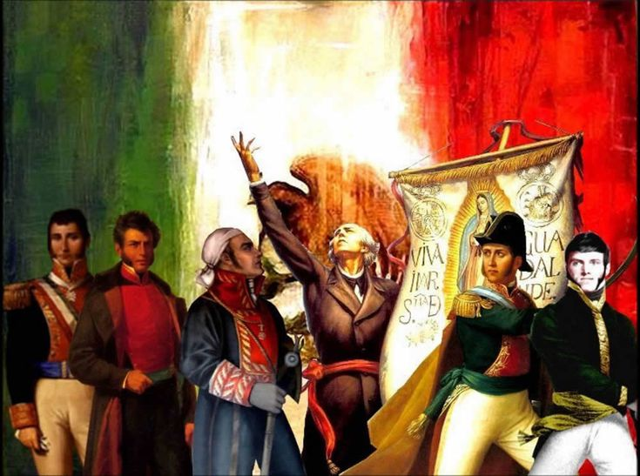
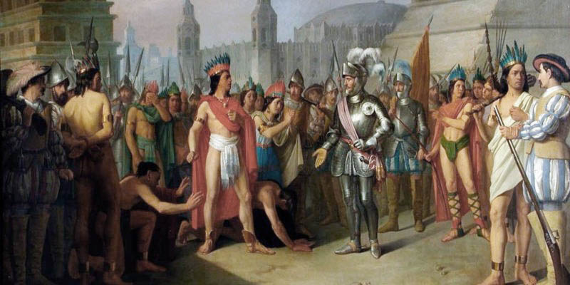
Short History of mexico
15,000 years ago people reach America
Today 62 languages alive, before not known
Arrival of Spanish in 1519
Independence of Mexico

Slide 4
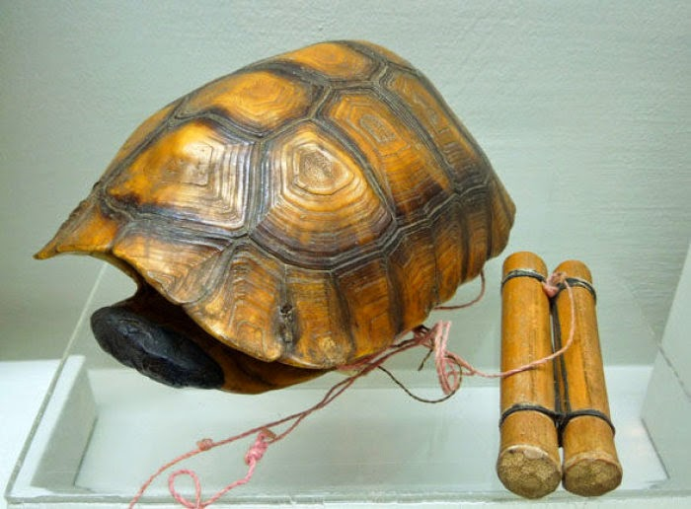
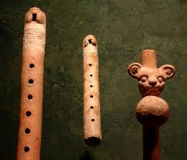
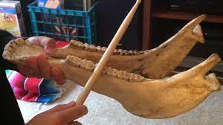
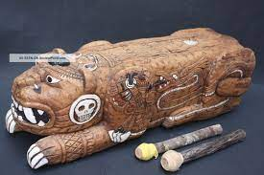
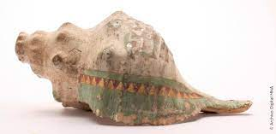
Prehispanic music

Slide 5

Prehispanic music

Slide 6
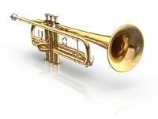
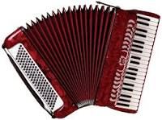
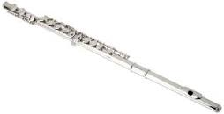
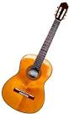
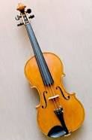
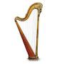
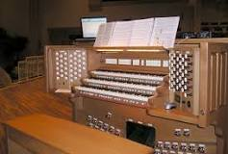
Traditional mexican music
Spanish people bring new instruments

Slide 7
Traditional mexican music
Mariachi (West)
Banda (North)
Son Jarocho (East)
Caribbean & South America (South)

Slide 8
Traditional mexican music

Slide 9
Thank you!
Does anyone have any questions?
addyouremail@greatppt.com
+00 000 000 000
www.greatppt.com

